Slide 1

GNOD Song Recommender
Dive into an ocean of sounds
Giorgio Lupo
Laura Sanjuán
Maria Pruteanu

Slide 2
Summary
Music role in our lives
The importance of music discovery
Who is it made for
Product Flow
GNOD Numbers
Market Opportunity
Conclusion

Slide 3
Music to me is like breathing. I don't get tired of breathing, I don't get tired of music.
Ray Charles
Notes:
As every movie has a soundtrack, so the movie of our lives. Music surrounds us in our happy and sad moments
Explain how music is accompanying us in our life most significant moments. The more accurate music we find, the better we can relate to our life experiences (or something like that). Cos music is so important, we want to explore…

Slide 4

The importance of music discovery
We want to help you to discover more sounds that can enrich your lives and define unforgettable memories

Slide 5
Music Recommender
Enhanced
NEW RECOMMENDER
BASED ON SIMILAR SOUNDS
OLD RECOMMENDER
BASED ON BANDS
Notes:
Band recommender takes into account other users bands. New recommender based on audio features

Slide 6
Who is it made for
Made for explorers
Made for real music lovers
Made for every music taste
Notes:
, who like to broaden their music horizon
, who wants to expand their music tastes, without any theoretical knowledge
From commercial to experimental

Slide 7
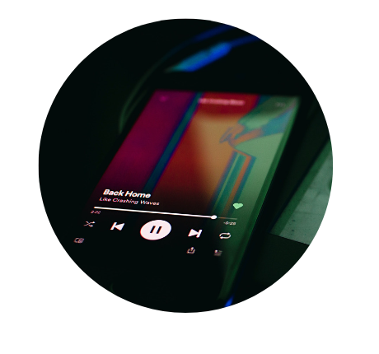

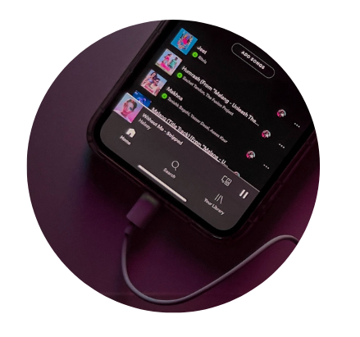
Product Flow
User enters song and artist
Machine-learning analyzes the song based on its audio features
Music suggestions for the user

Slide 8
GNOD Numbers
300k+
MONTHLY
GNOD
USERS
100k+
GNOD
BANDS

Slide 9
Growing Market Opportunity
616MLN
STREAMERS 2022
(7.1% UP FROM 2021)*
17BLN$ +
MARKET**
10%
ARTIST ACCOUNTS FOR 90% STREAMS***
*https://midiaresearch.com/blog/music-subscriber-market-shares-2022
**https://www.statista.com/statistics/587216/music-streaming-revenue/
***https://hellofuture.orange.com/en/music-recommendation-algorithms-what-influence-do-they-have-on-what-users-listen-to/

Slide 10
Conclusion
GNOD can provide a tailored-made customer experience in a growing market
After the realization of the demo, we are ready to create more customer-friendly solutions

